Slide 1
JOINS
RETRIEVING DATA FROM MULTIPLE TABLES

Slide 2
Joins are used to combine data from multiple tables to form a single result set
[INNER] JOIN ... ON
LEFT [OUTER] JOIN
RIGHT [OUTER] JOIN
FULL [OUTER] JOIN

Slide 3
Different Types of SQL Joins
Inner join: It returns records that have matching values in both tables.
Table 1
Table 2

Slide 4
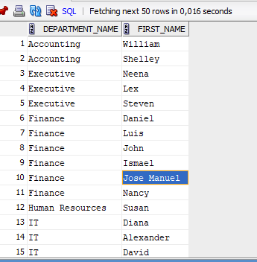
INNER JOIN-ANSI
SELECT d.department_name,
e.first_name
FROM departments d
JOIN employees e ON d.department_id = e.department_id
WHERE d.department_id >= 30
ORDER BY d.department_name;

Slide 5
INNER JOIN-NON ANSI
SELECT d.department_name,
e.first_name
FROM departments d, employees e
WHERE d.department_id = e.department_id
AND d.department_id >= 30
ORDER BY d.department_name;

Slide 6
Different Types of SQL Joins
Left (outer) join: A LEFT [OUTER] JOIN returns all valid rows from the table on the left side of the JOIN keyword, along with the values from the table on the right side, or NULLs if a matching row doesn't exist.
Table 1
Table 2

Slide 7
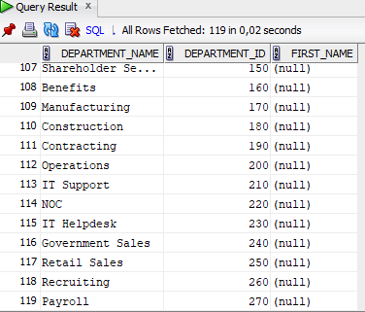
A LEFT [OUTER] JOIN-ANSI
SELECT d.department_name,
d.department_id,
e.first_name
FROM departments d
LEFT OUTER JOIN employees e ON d.department_id = e.department_id
WHERE d.department_id >= 30
ORDER BY d.department_id, e.first_name;

Slide 8
A LEFT [OUTER] JOIN-NON ANSI
SELECT d.department_name,
e.first_name
FROM departments d, employees e
WHERE d.department_id = e.department_id (+)
AND d.department_id >= 30
ORDER BY d.department_name, e.first_name;

Slide 9
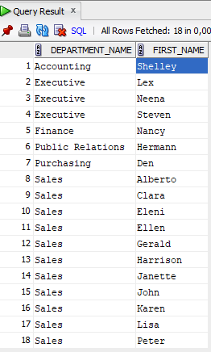
A LEFT [OUTER] JOIN-NON ANSI
No null values
Adding filters to columns returned from an outer joined table is a common cause for confusion. If you test for a specific value, for example "salary >= 10000", but the value for the SALARY column is NULL because the row is missing, a regular condition in the WHERE clause will throw the row away, therefore defeating the object of doing an outer join. Both the ANSI and non-ANSI methods have a way of dealing with this.
SELECT d.department_name,
e.first_name
FROM departments d
LEFT OUTER JOIN employees e ON d.department_id = e.department_id
WHERE d.department_id >= 30 and e.salary >= 10000
ORDER BY d.department_name, e.first_name;

Slide 10
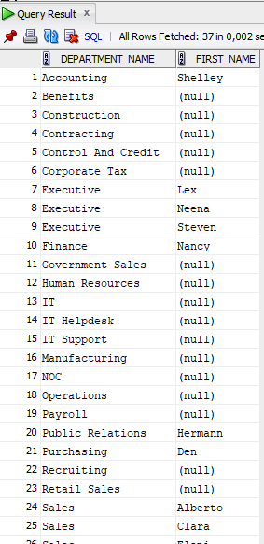
A LEFT [OUTER] JOIN-NON ANSI
There are null values
Using the ANSI join syntax, filters on columns from the outer joined table are included in the join itself, rather than being placed in the WHERE clause.
SELECT d.department_name,
e.first_name
FROM departments d
LEFT OUTER JOIN employees e ON d.department_id = e.department_id AND e.salary >= 10000
WHERE d.department_id >= 30
ORDER BY d.department_name, e.first_name;

Slide 11
A LEFT [OUTER] JOIN-NON ANSI
There are null values
Using the non-ANSI join syntax, the "(+)" is used to indicate a column may have a NULL value as a result of an outer join.
SELECT d.department_name,
e.first_name
FROM departments d, employees e
WHERE d.department_id = e.department_id (+)
AND e.salary (+) >= 10000
AND d.department_id >= 30
ORDER BY d.department_name, e.first_name;

Slide 12
RIGHT [OUTER] JOIN
The RIGHT [OUTER] JOIN is the opposite of the LEFT [OUTER] JOIN. It returns all valid rows from the table on the right side of the JOIN keyword, along with the values from the table on the left side, or NULLs if a matching row doesn't exist. All points raised in the previous section apply here also.
Table 1
Table 2

Slide 13
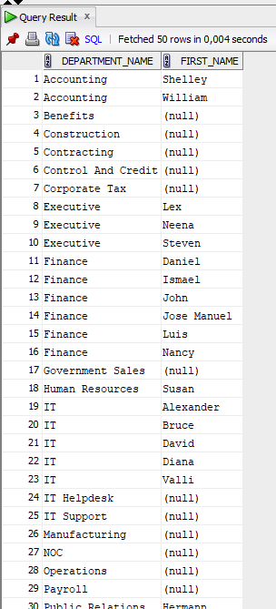
RIGHT [OUTER] JOIN
SELECT d.department_name,
e.first_name
FROM employees e
RIGHT OUTER JOIN departments d ON e.department_id = d.department_id
WHERE d.department_id >= 30
ORDER BY d.department_name, e.first_name;

Slide 14
FULL [OUTER] JOIN
A FULL [OUTER] JOIN combines all the rows from the tables on the left and right sides of the join. If there is a conventional match it is made. If either side has missing data, it is replaced by NULLs, rather than throwing the row away.
Table 1
Table 2

Slide 15
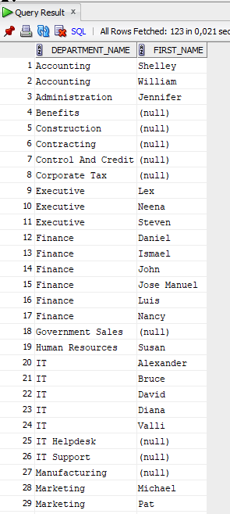
FULL [OUTER] JOIN-ANSI
SELECT d.department_name,
e.first_name
FROM employees e
FULL OUTER JOIN departments d ON e.department_id = d.department_id
ORDER BY d.department_name, e.first_name;

Slide 16
FULL [OUTER] JOIN-NON ANSI
SELECT d.department_name,
e.first_name
FROM employees e, departments d
WHERE e.department_id = d.department_id (+)
UNION ALL
SELECT d.department_name,
e.first_name
FROM departments d, employees e
WHERE d.department_id = e.department_id (+)
AND e.first_name IS NULL
ORDER BY 1, 2;

